Slide 1
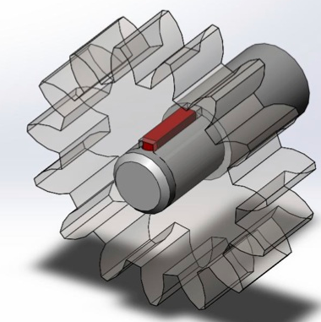
BASIC MECHANICAL ENGINEERING
Unit –I: Introduction to Mechanical Engineering
(Shaft & Keys)

Slide 2
Introduction to Machine:
Device consisting of various elements to perform the prescribed task to satisfy the human needs
E.g. Pump Set, IC Engine, Turbine etc.
INPUT
(Source of Energy)
Machine
(Arrangements of Elements)
Output
(Prescribed Task)

Slide 3
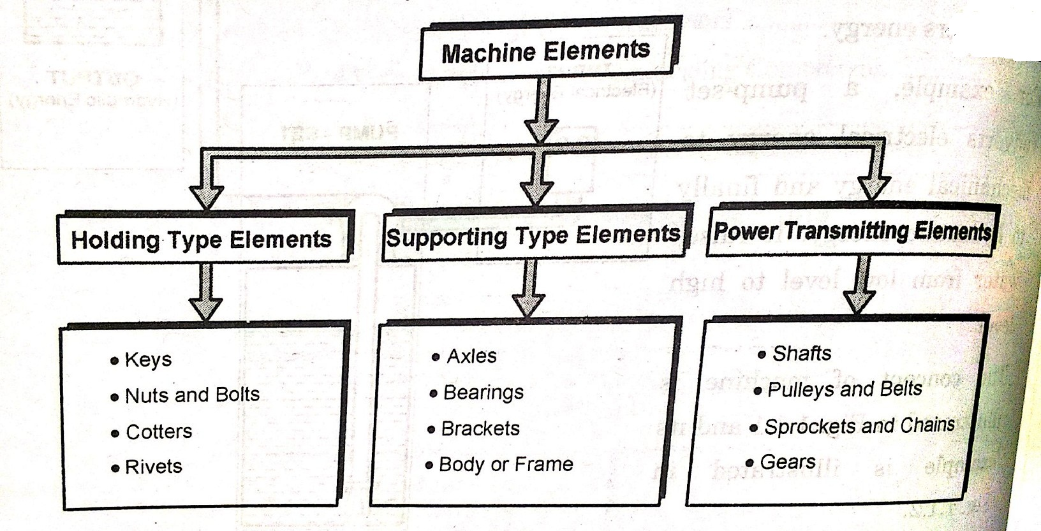
Classification of Machine Elements:

Slide 4
Shafts:
A shaft is a rotating member, circular cross-section, solid or hollow, to transmit power or motion
To transmit the power using shaft different members are used such as, Gears, Pulleys, Sprockets
Types:
A) Transmission Shaft
B) Machine Shafts

Slide 5
A) Transmission Shafts:
Transmit the power from source to the machine absorbing the power
Mountings: Gears, Pulleys etc.
Subjected to torque, BM and axial force
Types: Line Shaft and Counter Shaft

Slide 6
Difference between Line shaft & Counter Shaft:
Sr. No. | Line Shaft | Counter Shaft
1. | Directly driven by prime mover and using this power is supplied to diff. machines | Secondary shaft driven by main shaft using belt, chain or gear
2. | Directly connected to PRIME MOVER | NOT DIRECTLY CONNECTED

